Slide 1

Crop Disease based on historical data using Spark and Hive
Sprint Evaluation

Slide 2

Under the Guidance of :
Sandeep Agarwal
Team Members
Aditya Raj Jha
Aishwarya Rajendra Shirode
Akshita Ashwin Shinde
Ankathi Sudhamsh
Ankit Kumar

Slide 3
Table of Contents
01
04
07
02
05
08
03
06
Scope of Project
Approach
Commands
A Brief Intro
Our approach of handling the project
Commands Performed
Technologies used
Datasets
Queries
All the softwares used
Queries executed
Contains all the tables used with hyperlinks
WorkFlow
Project Star Schema
Step by Step Execution
Fact and Dimension tables structure

Slide 4
Scope of Project
Plant diseases cause a major production and economic losses in the agricultural
industry. Disease management is a challenging task. Usually the diseases or its
symptoms such as colored spots or streaks are seen on the leaves of a plant. In plants, mostly the leaf diseases are caused by fungi, bacteria, and viruses. The diseases caused due to these organisms are characterized by different visual symptoms that could be observed in the leaves or stem of a plant.

Slide 5



Technologies Used

Slide 6

WorkFlow

Slide 7
Approach
Creation of datasets in csv format.
Creation of raw database in sql and created all the required tables using create command.
Loaded data in spark which resulted in creation of dataframes.
Afterwards we registered temporary table
Transformation of raw data into fact and dimension table.
In hive, a database as dwh_parquet was created.
We export the data from spark to hive.
The solutions can be found by running queries in hive.

Slide 8






Datasets
Place
Farmer
Crop
Reason
Disease
Cultivation

Slide 9
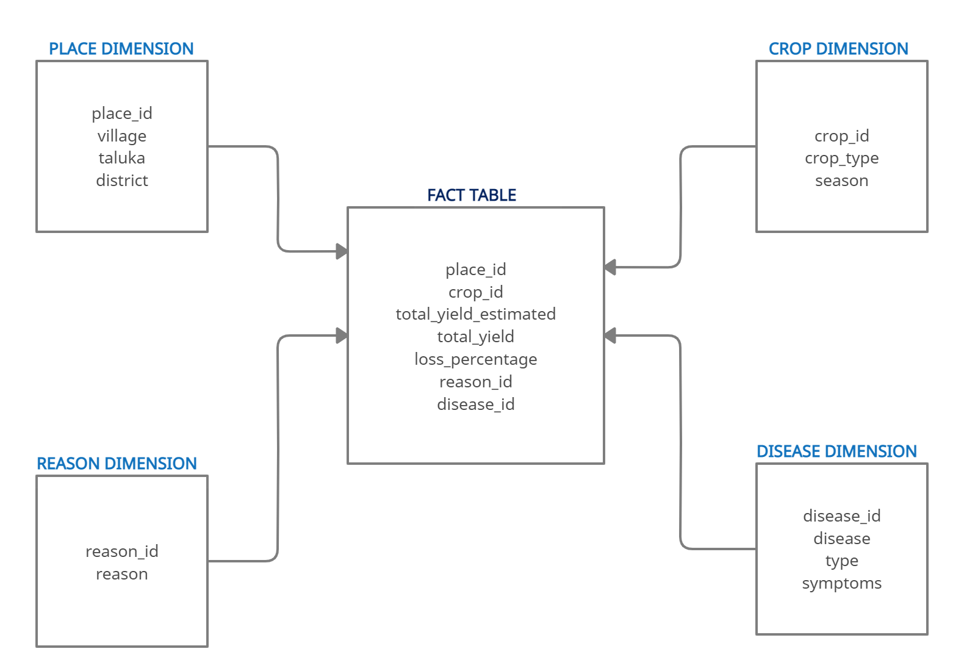
Project Star Schema

Slide 10

Commands
SQL Commands : We’re using SQL commands for the creation of RAW Database(containing our datasets)
Spark Commands : We’re using Spark for the three process-
Creation of Dataframes
Registering temporary tables
Transformation
Spark Commands Output

Slide 11
Queries
1) Display loss percentage of distinct villages .
select f.place_id, p.village, f.loss_percentage
from fact f join place_dim p
on f.place_id = p.place_id
where f.loss_percentage > 0.00
order by f.loss_percentage desc;
Output:
114 Varshi 23.08
226 Itave 21.05
210 Andhari 17.74
227 Waghare 16.67
118 Palshet 15.91
218 Shelgaon 15.91
220 Ambadi 15.79
101 Agartakali 12.5

Slide 12
2) Display the disease which is affected to the crops where loss_percentage is maximum:
select f.place_id, p.village, f.loss_percentage, d.disease_name
from fact f join place_dim p
on f.place_id = p.place_id
join disease_dim d
on f.disease_id = d.disease_id
where f.place_id = 114;
Output:
114 Varshi 23.08 snow mold

Slide 13
3) Display disease according to seasons and crop_type:
select f.crop_id,c.crop_type,f.disease_id, d.disease_name
from fact f join crop_dim c
on f.crop_id = c.crop_id
join disease_dim d
on f.disease_id = d.disease_id
order by f.crop_id;
Output:
301 Arhar/Tur 502 bacterial wilt
301 Arhar/Tur 500 Invalid Disease
301 Arhar/Tur 502 bacterial wilt
302 Bajra 500 Invalid Disease
302 Bajra 529 psorosis
302 Bajra 506 rot
303 Cotton 519 gray mold rot

Slide 14
4) Display reason according to crop seasons.
select f.crop_id, c.season, f.reason_id, r.reason
from fact f join crop_dim c
on f.crop_id = c.crop_id
join reason_dim r on
f.reason_id = r.reason_id
order by f.crop_id;
Output:
301 Kharif 401 Diseases
301 Kharif 401 Diseases
301 Kharif 405 Acidity Stress
302 Kharif 401 Diseases
302 Kharif 401 Diseases
302 Kharif 406 Floods
303 Kharif 402 Heat Stress

Slide 15
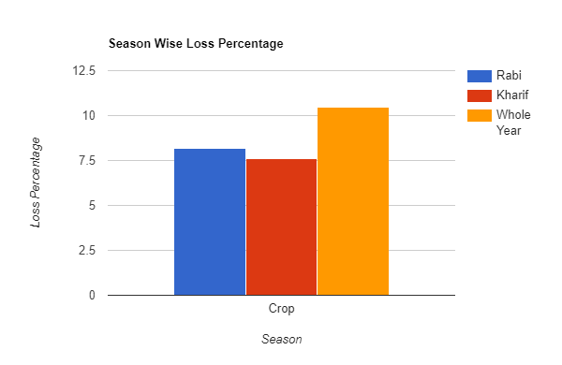
5) Calculate loss_percentage,according to seasons.
select c.season, round((sum(f.total_yield_estimated)-sum(f.total_yield))/sum(total_yield_estimated)*100,2)
from fact f join crop_dim c
on f.crop_id = c.crop_id
where f.loss_percentage > 0.00
group by c.season;
Output:
Kharif 7.58
Rabi 8.18
Whole Year 10.47

Slide 16
6) Display diseases as per village:
select f.place_id, p.village,f.disease_id,d.disease_name
from fact f join disease_dim d
on f.disease_id = d.disease_id
join place_dim p
on f.place_id = p.place_id
where f.disease_id != 500
order by f.place_id;
Output:
101 Agartakali 502 bacterial wilt
102 Panchak 506 rot
104 Metgharkilla 523 snow mold
105 Girnare 519 gray mold rot
107 Shirale 508 anthracnose
109 Manori 509 black knot
110 Vanarvadi 516 leaf blister

Slide 17
THANK YOU

